Slide 1
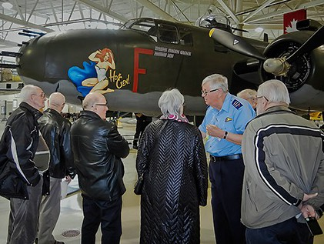
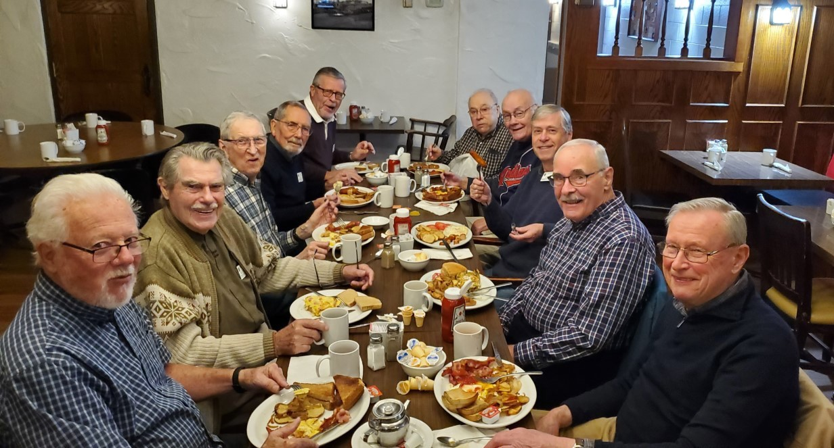
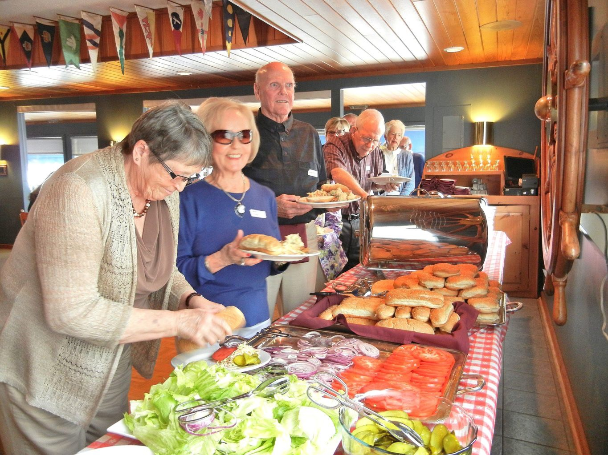
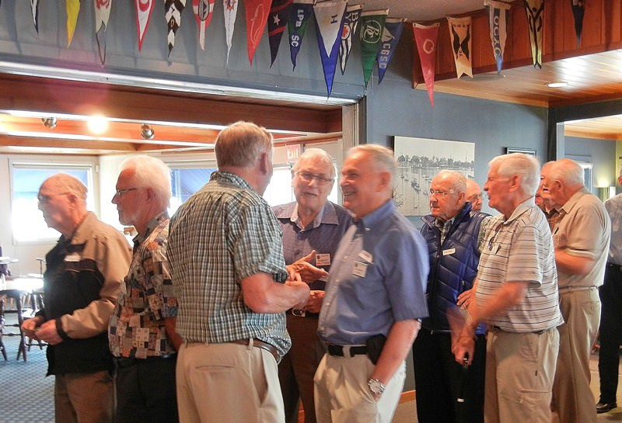
Fellowship
Sharing
Friends
Fun
Since 1988
Meeting the second Tuesday of each month at 9:30 am

Slide 2
Fellowship; Friendship and Fun
Probus

Slide 3
Probus, an acronym for Professional and Business, evolved from the Rotary Club in England in 1966.

Slide 4
Probus has grown worldwide and has about 250 clubs in Canada

Slide 5
Probus Canada is the umbrella core which guides all other clubs while retaining their autonomy

Slide 6
Probus has about 4,000 clubs worldwide. Probus Global enjoys about 1,000 members and meets monthly online

Slide 7
Probus is open to retired or semi-retired professionals and business people plus others

Slide 8
There are men only, women only, and combined clubs. Men and combined clubs are available in St Catharines

Slide 9
The Probus Club of St Catharines, men only, meets on the 2nd Tuesday of each month at the Grantham Lions Club on Niagara Street

Slide 10
Interesting Guest Speakers provide informative and interesting subjects of interest to members.

Slide 11
Educational visits; Lunches; Breakfasts plus other outings and activities are optional extras

Slide 12
We have an excellent monthly newsletter; the “Probe”

Slide 13
We currently enjoy about 85 active members with meetings’ turnout of about 55%. Annual dues are currently $40.00

Slide 14
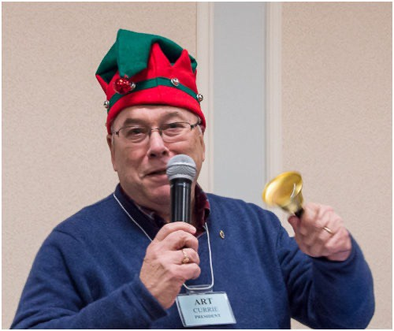
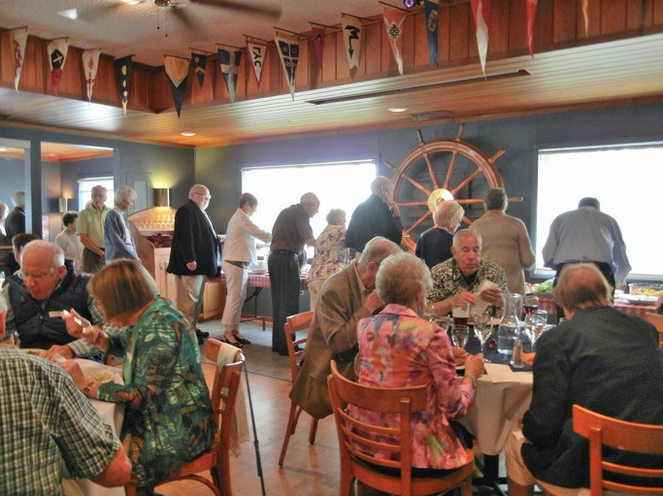
Why join a Probus Group?
Meeting new people, making new friends, and discovering new interests are just some of the advantages of being a PROBUS member.
PROBUS stimulates thoughts, interest and participation in activities at a time in life when it is easy to become complacent.

